Slide 1


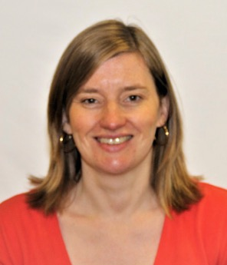
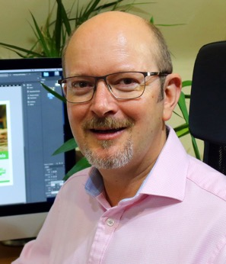
Partnership working
Helen Edwards
Derwen College
Neil Bevan
Starfish Labs
Notes:
Good morning.
We are Helen Edwards from Derwen College and Neil Bevan from Starfish Labs. We are here to talk to you about partnership working between Derwen College and Starfish Labs on a project that we have been working on for the last 4 years.

Slide 2


Funding
Notes:
Helen
For this project we originally put in a bid for funding as part of a Marches-wide skills project called “Investing in Our Future Workforce”. We applied for funding via the Marches LEP which was part of the Growth Deal where £104million was invested into the Marches area (Herefordshire, Shropshire and Telford & Wrekin).
Our original bid was part of a larger joint bid with other regional colleges around getting people into work.
The original group bid changed and we actually ended up being funded as an individual project.

Slide 3
Project objectives
To support people with learning difficulties and disabilities into work.
Supporting
individuals
Supporting
businesses
Notes:
Helen
Our project funding was specifically around getting people with learning difficulties and disabilities into work.
There were two ways we aimed to do this.
The first was to create a series of apps that would be able to support individuals into work.
The second was to support businesses to enable people with learning difficulties and disabilities into work.
Funding was for a three year project but the outputs deadline has been extended due to Covid pandemic.

Slide 4


Identifying an app
delivery partner
Notes:
Helen
We needed to find the right company to work with to create the apps.
When we went out to tender for the app project it was clear that a local company, Hunter Bevan, were the most experienced in terms of understanding of how we work and the aims we were trying to achieve.
They had experience of working with specialist colleges and Natspec in the past and they understood the needs of our students who would be testing the apps.
Neil
The project partnership has been so successful that Hunter Bevan, a graphic design, marketing and web development company, recognised the future potential and we actually created a new company – Starfish Labs - to specialise in the development of apps for Special Educational Needs and Disabilities and ‘apps for good’ as a result of working on this project.

Slide 5
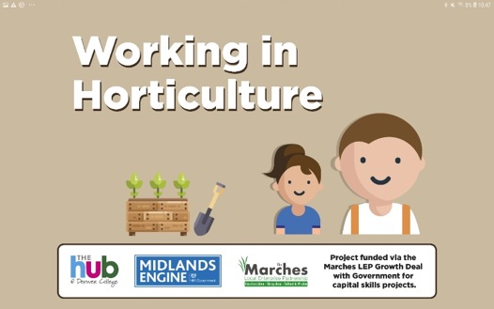
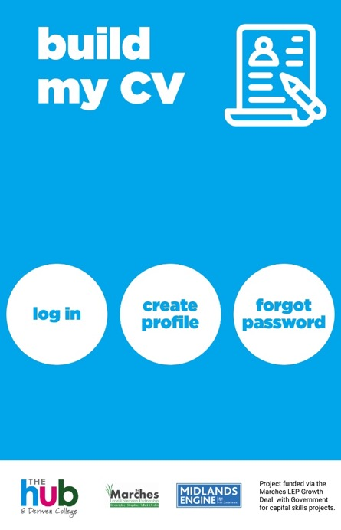
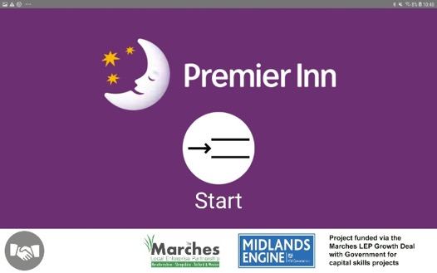
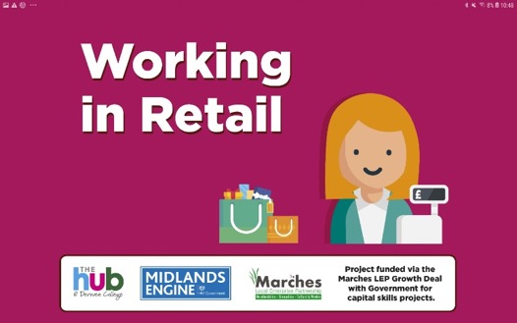
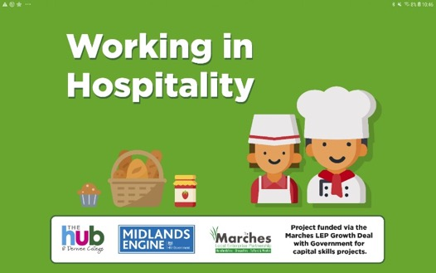
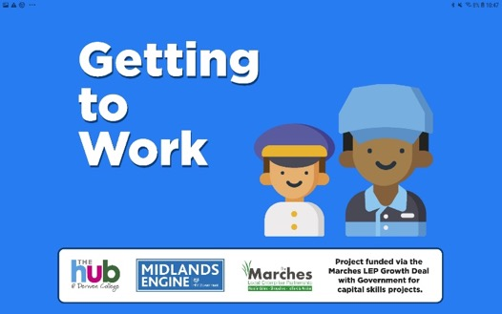
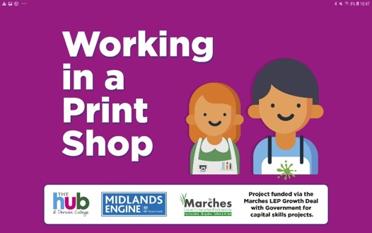
Working together
Notes:
Helen
Derwen identified the ideas – we talked to students about what they needed
Discussed with Starfish
Starfish looked at the technicalities of the proposals and came up with the solutions

Slide 6
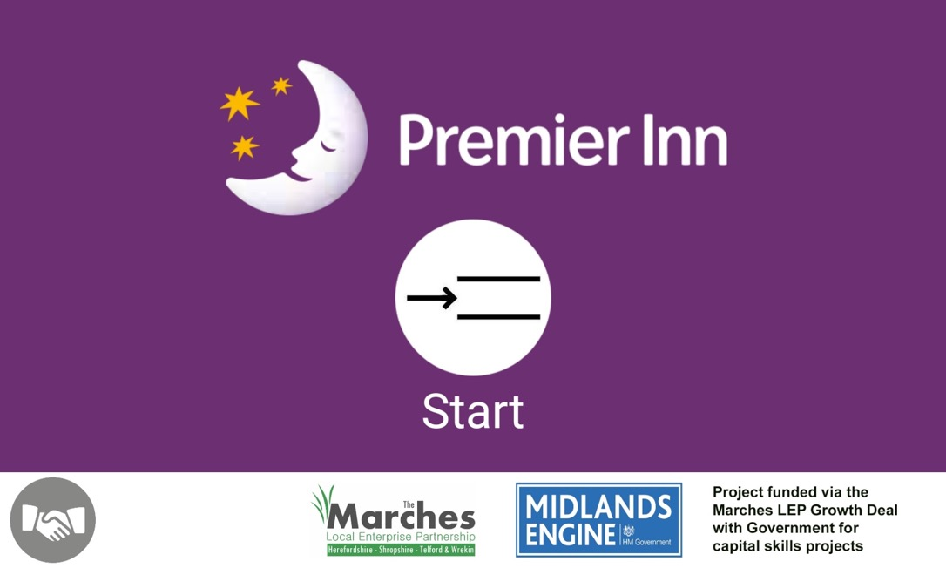
Premier Inn App
Notes:
Helen
The most obvious app to create was the Premier Inn app. The students were already working with Premier Inn resources which used ‘routes’ around the bedroom as a routine for cleaning and preparing for guests.
To create this app we relied on Starfish’s advice and vision for what could be achieved. Contacts they had in terms of video and photography. Derwen provided the content and also liaised with Makaton to get a license to use the symbols on the app.

Slide 7
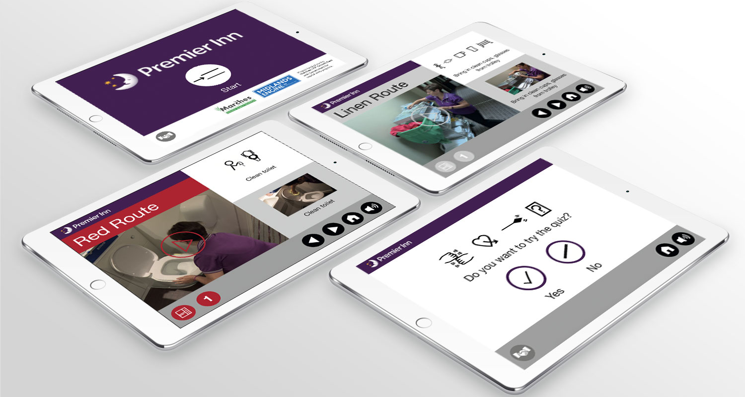
Premier Inn App
Notes:
Neil
The paper based resources that students used to learn the routes were simplified into manageable steps and transformed into an app that used 3 different visual cues:
Makaton & text, video and sound (voice), and images & text.
This allowed the students to choose which learning method they preferred.
We also included a level of ‘gamification’ – a fun spot the difference quiz to evaluate learning outcomes.
Derwen students took part in the filming and voice recording sessions so they could see how the content was created.

Slide 8
Pathway Apps
Notes:
Helen
The next series of app we created were based on the pathways in the college as these represent the sort of jobs that our students get after leaving work.
This was to support students going out on work experience with the view to expand this to anyone who worked in that industry.
These apps differed from the Premier Inn app as they are designed to be updated by the teacher or the workplace. So we needed to keep these apps quite simple.
We first looked at creating the Hospitality app and were aware that different cafés have different ways of making food and drinks. So we knew that we couldn’t have a one-size-fits-all approach to the pathway apps. While one café might make a cup of tea with an urn and a teapot, another café might make a cup of tea with a mug, and tea bag and a vending machine for hot water.
The app needed to be able to reflect the diversity of the industry.

Slide 9
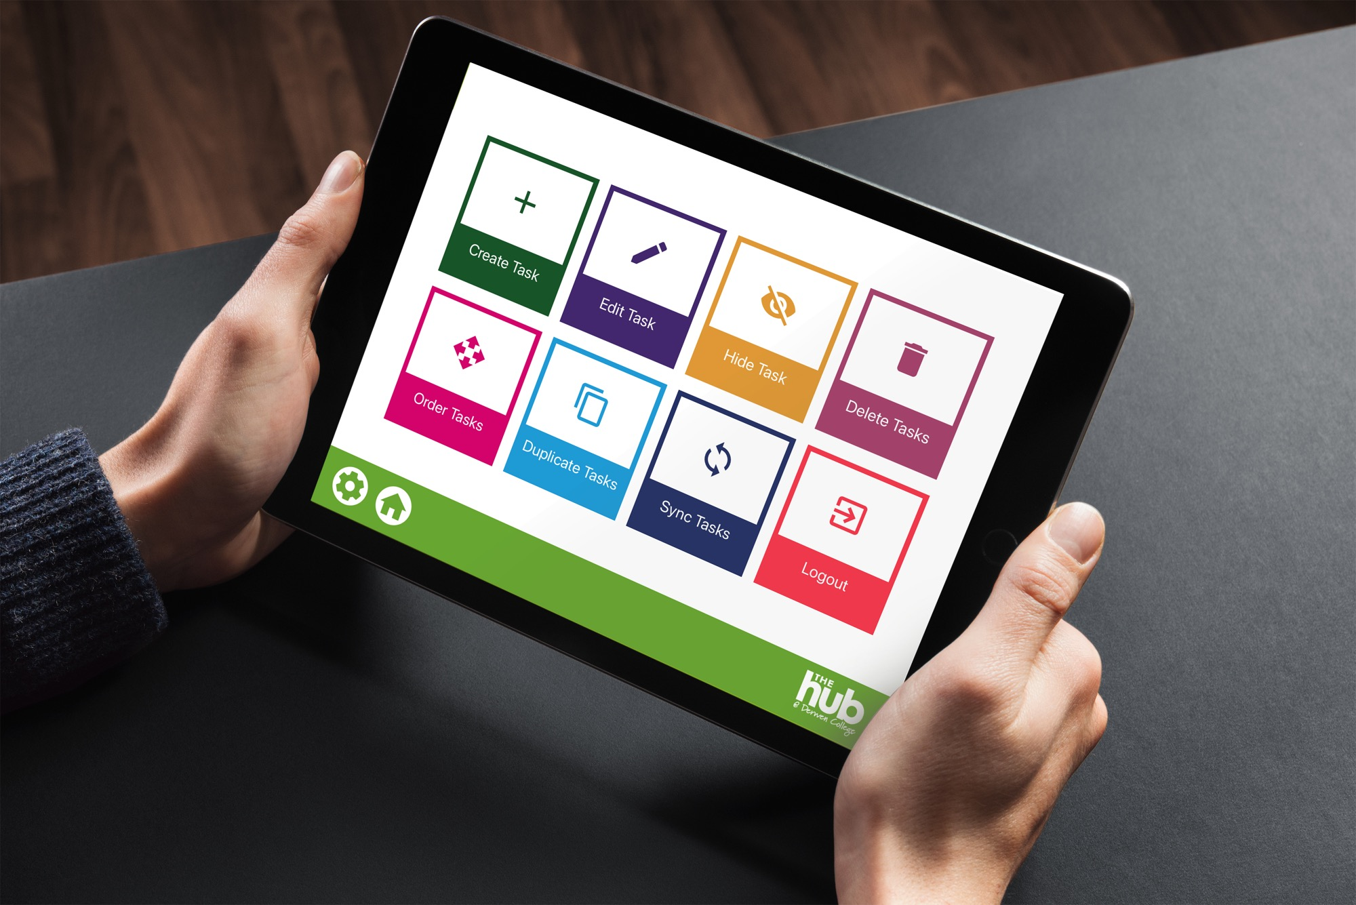
Notes:
Neil
Our challenge here was how to enable a workplace provider to show students their own ways of working. As Helen said, there are a million ways to make a cup of tea!
We came up with the idea of an ‘app engine’ that would allow a teacher or a trainer at a work placement to create their own content in the app.
You can see the controls they have to create and edit tasks on the screen.

Slide 10
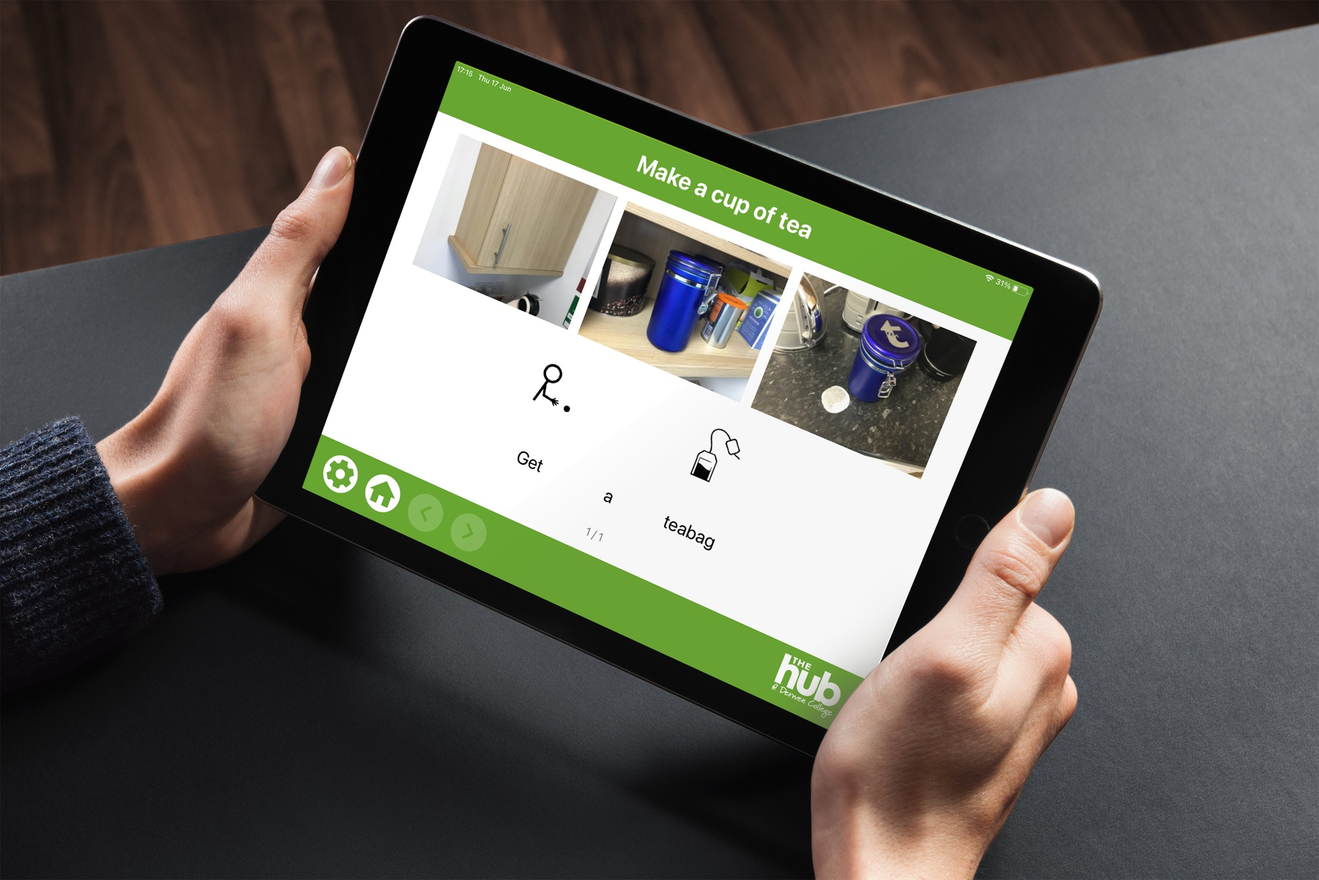
Notes:
Neil
These apps allows users to create tasks with individual steps. Each step can have up to three images and use text and Makaton symbols if they wish to use them.
These steps can be as simple or as complex as needed for the student – for example, ‘get a mug’ - or ‘go to the cupboard’, ‘you will see mugs and cups’, ‘pick up a mug’… and so on.

Slide 11

CV Builder
App
Notes:
Helen
The CV builder app came about because for years we have realised the frustrations that students have when trying to write a CV.
Traditional CVs are an obscure concept to many of our students. They aren’t tangible, and they are not set in the present moment. We all know students have a wide range of skills but very often are unable to write about these skills and experiences.
Over the years we have tried many different ways of creating CVs for students, but haven’t been able to create something that is intuitive to use – until now.

Slide 12
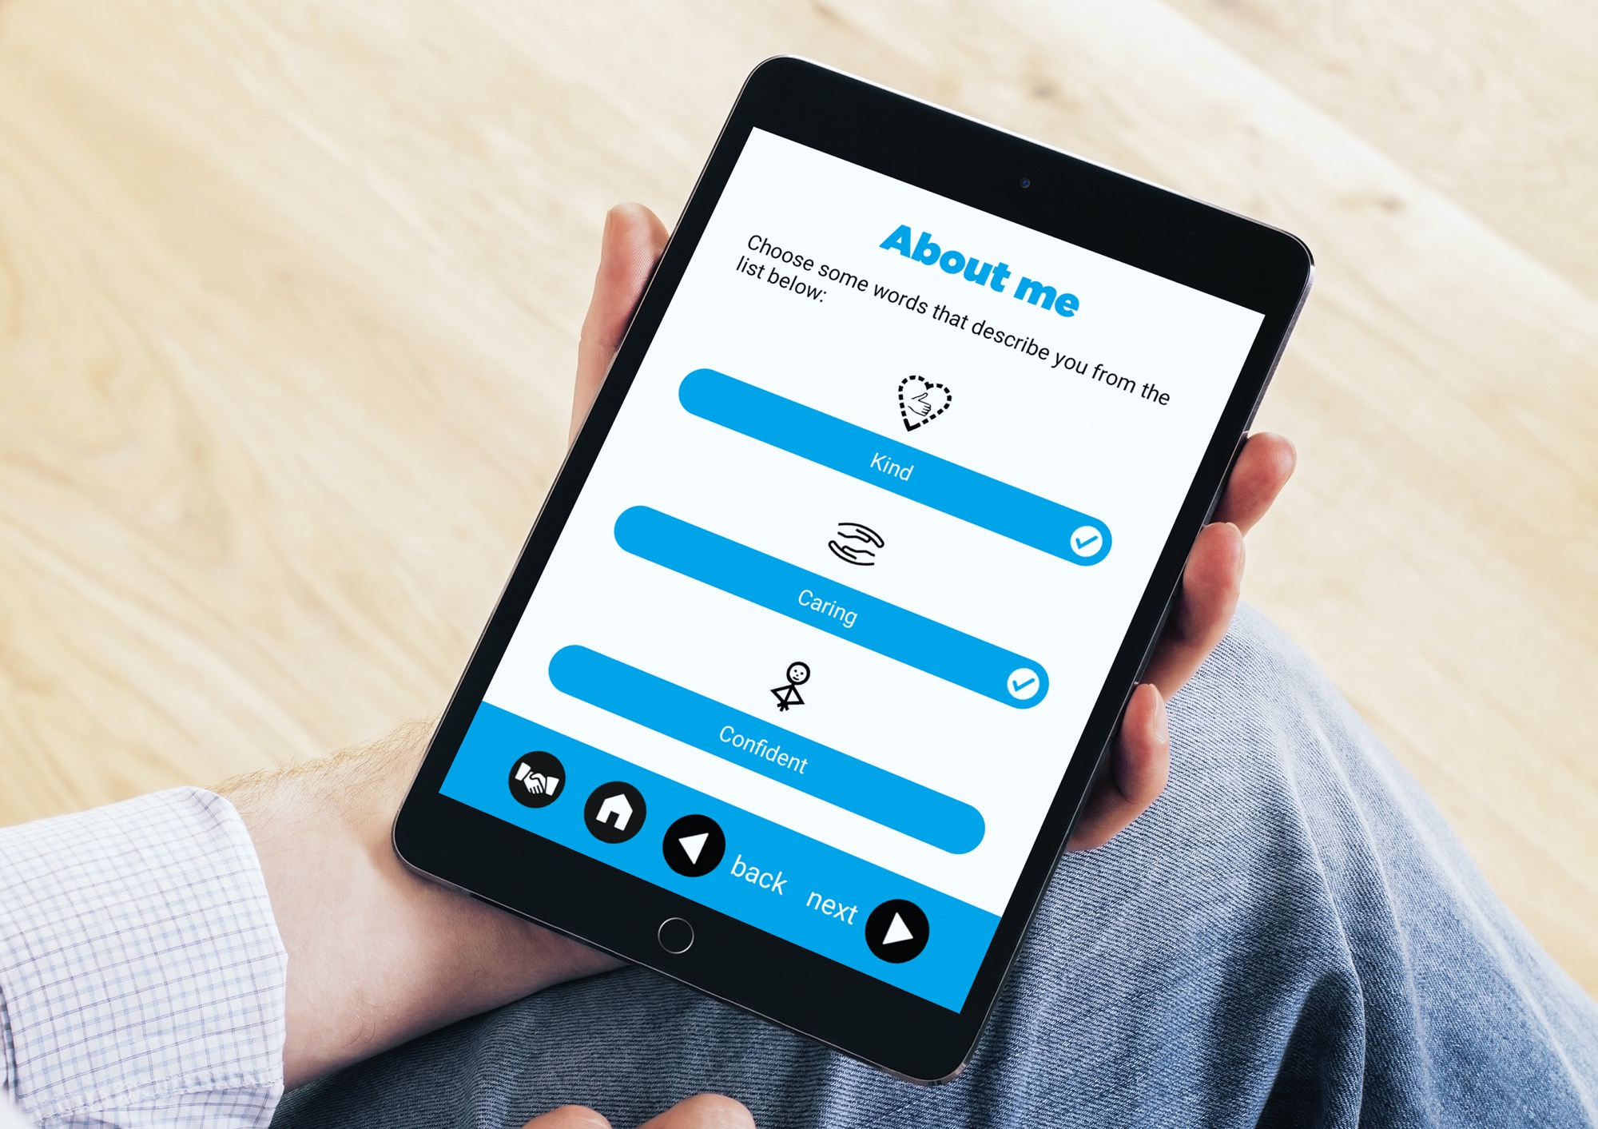
Notes:
Helen
The aim with this app was to try to create a CV builder where students could choose from skills options, and also backup their choices with picture and video evidence as well as free-text boxes if they wanted it.

Slide 13
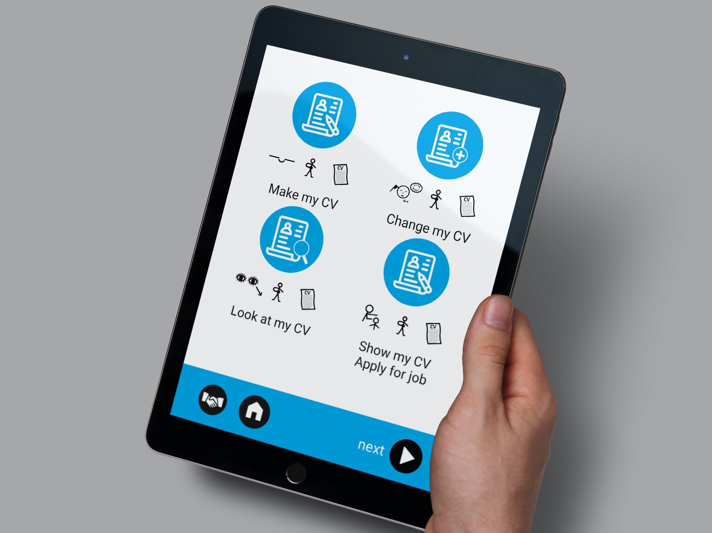
Notes:
Helen
The CV they create can be emailed to potential employers. The CV would then contain text, images and also a link to videos.

Slide 14
CV Builder App
Notes:
Neil
For this app we had to consider the implications of safeguarding and the complexities around GDPR in storing personal data.
The flowchart on the screen shows that apps can be quite complicated. This app needs to communicate with a server that keeps the data secure and with a website ‘back end’ where college staff can edit content and share CVs.
We created a login system for an ‘admin’ user to create a profile and then a separate login for a student to create their CV – and also a system to send a CV to a potential employer with a link to access the pdf CV and links to video hosted separately.
The data held in the database is not all held in one place and would be very difficult to identify different pieces of data against a particular student.

Slide 15
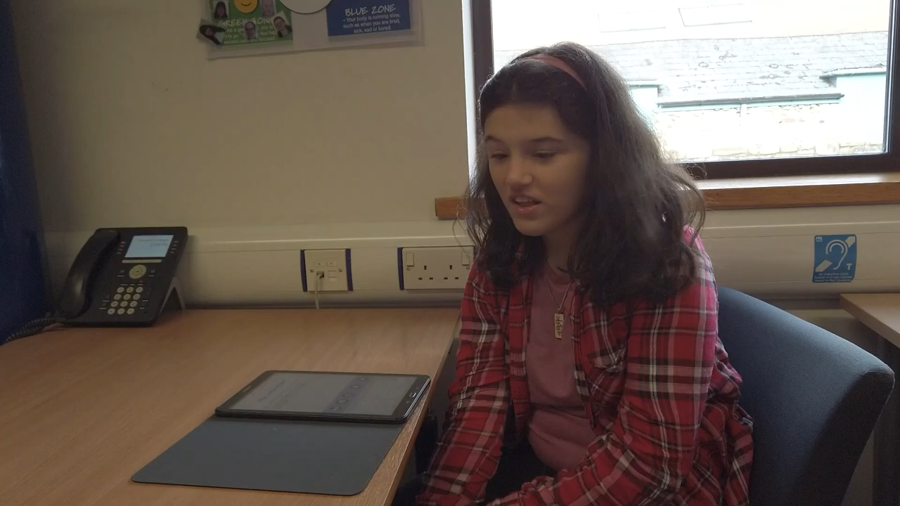
Notes:
Helen
The students really like using the CV builder app
The student feedback is the best test of how the apps are performing in helping them to understand the work placement tasks.
The apps are now being tested more fully in the college pathways to give further feedback for ongoing improvement in the future.
Let’s hear what AJ thinks of the CV app….

Slide 16
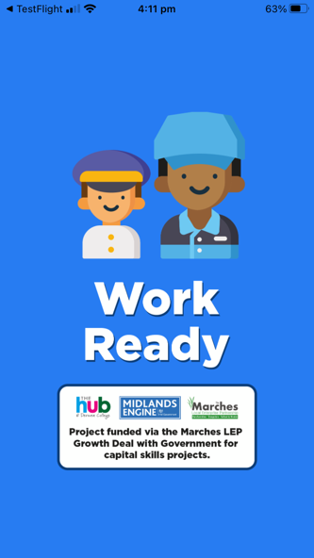
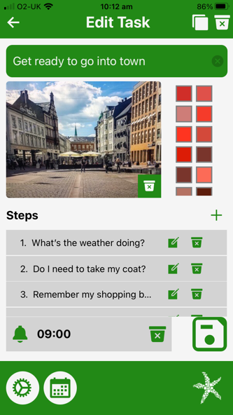
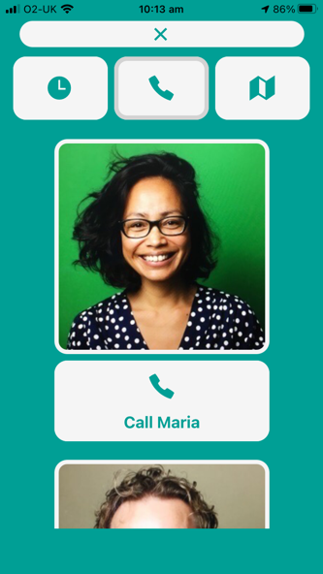
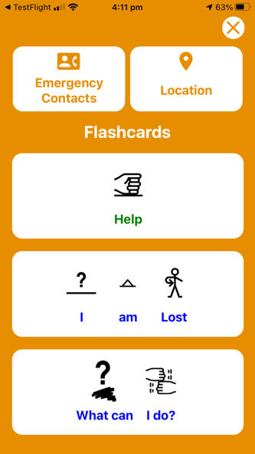
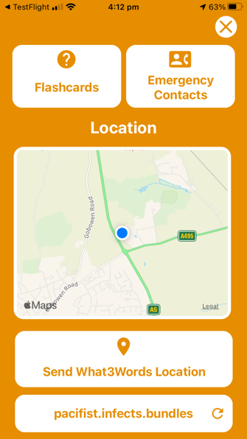
Work Ready App
Notes:
Neil
The last ‘large’ app will be the Work Ready app which is currently being tested by students.
This has a range of support for students to use to help them get ready for - and to travel independently – to and from work.
It started off as a journey planning app, but when we talked to teachers and students further, we changed the approach and turned it into a visual calendar with journey planning as part of the functionality.
Students can set reminders to prepare for work the night before, record travel arrangements through images, video and text, what they should do if they get lost or if their bus or train is cancelled.
The app also includes a simple touch system for contacts and is what3words enabled to help a user describe where they are within 3 metres by sending the what3words location in a text as sometimes the words used in that system can be difficult to read or pronounce.
Students have been testing the prototype with their travel mentor to give us feedback on how they will use it and how it can be improved.

Slide 17
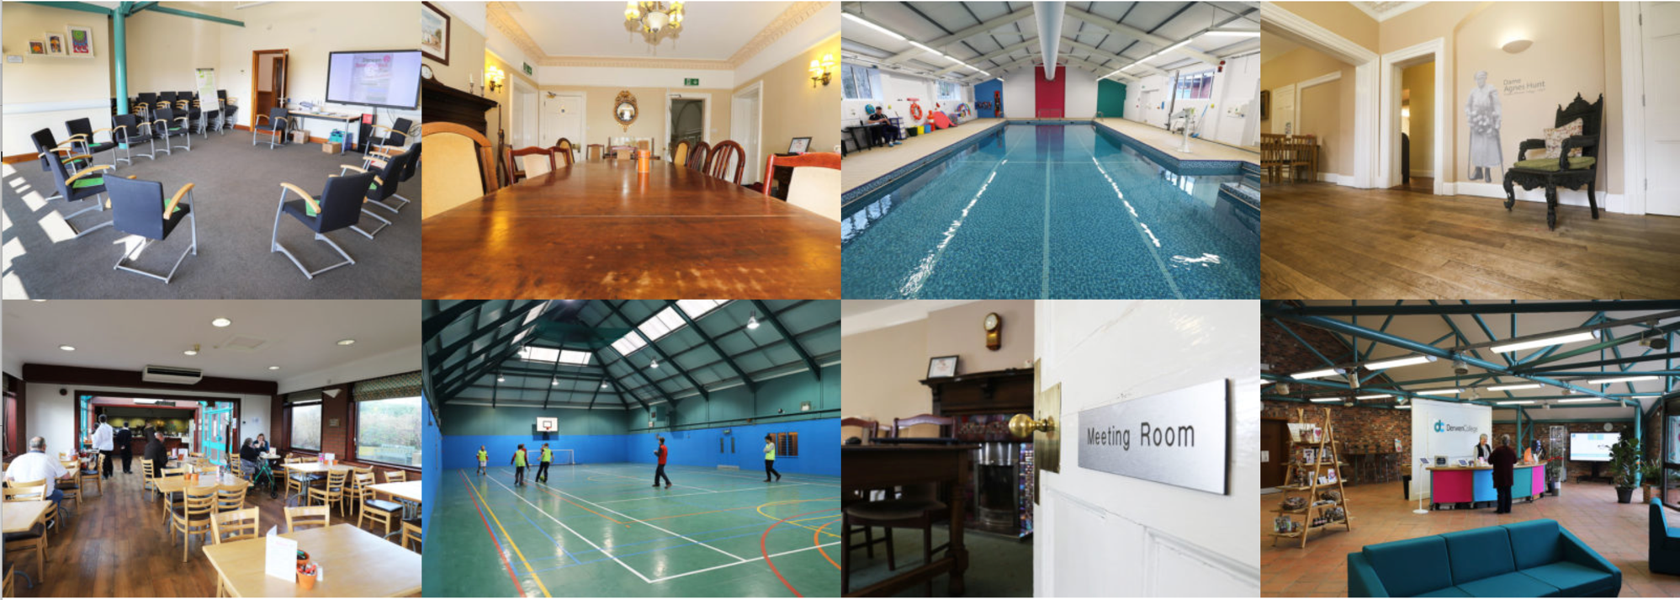
Working together
to support businesses
Notes:
Helen
As part of the plan to support businesses we created The Hub which was a series of meeting rooms in which we hire out to businesses, and provided training should they require it. Very much individual to the business.

Slide 18
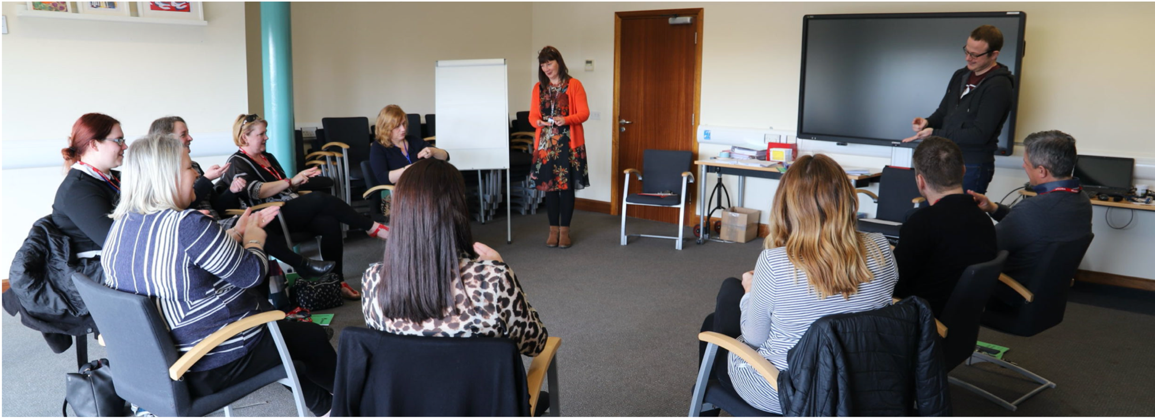
Working together
to support businesses
Notes:
Helen
But some of the training provided was around Makaton, Autism and general awareness of how businesses can support people with learning difficulties into work.
Supporting businesses has been one of the most impacted areas of the project as we haven’t been able to have external groups on-site. However, things are starting to open up slowly and we have recently been able to welcome some business groups in.

Slide 19
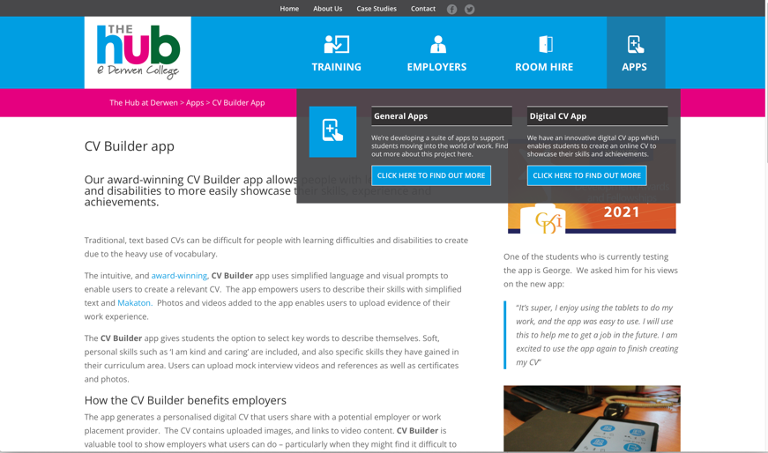
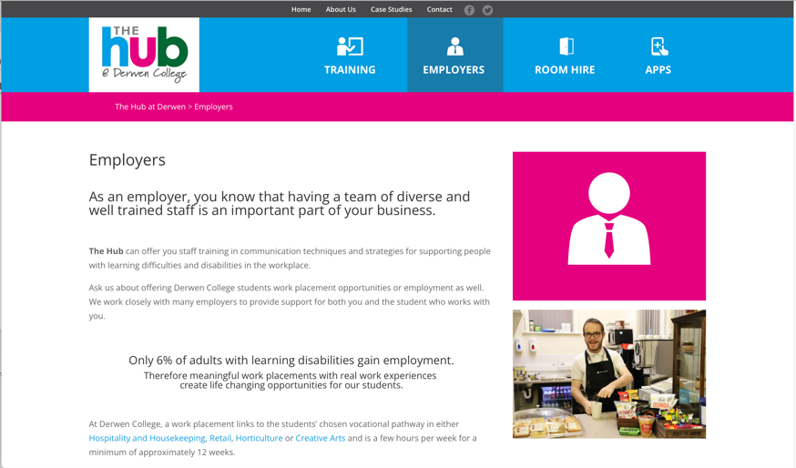
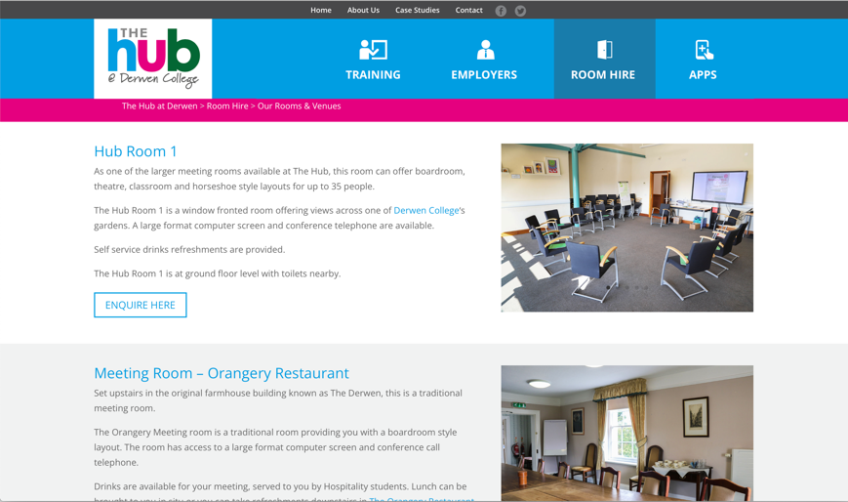
Working together
to support businesses
Notes:
Neil
The partnership work with Starfish around The Hub was to create a website to advertise the meeting rooms and to provide an information point for the apps.

Slide 20









Problems
Notes:
Helen
Problems
Problems we came across on the journey:
Pandemic
Co-ordination of different areas.
Changes in staff.
Pace - Time and speed of development. At Derwen we are fitting the project around our other work. Asking teachers to test apps and add content.
Neil
One of the problems to consider was GDPR and safeguarding – we needed to ensure that data is as safe and secure as possible
One issue was mobile data usage which could get expensive. All the data for the pathway apps is held on the device so it doesn’t need to be connected to the internet in use, but can be updated when it is connected to WiFi so it’s not using mobile data.
If we’re looking to roll out the apps to other colleges, e.g. the CV builder - the back end databases need to be totally separate and unique to the college – and what happens if the student wants to continue using the app when they have left college and the college would still be able to see their personal data? We’ve set up a system where we can duplicate the apps and have a totally separate back end keeping data secure.
One issue was Log ins – we were going to use fingerprint recognition – but some of the learnings were that some people don’t have the same fingerprint patterns as much of society or the dexterity to use touch ID so that can cause issues with some technology – so we needed to keep it simple.
Getting around development problems, takes discussion and research.
In a commercial situation a client is much more demanding and timescales are much shorter – In education things seem to take much longer for the reasons Helen mentioned – but that gives time to really think about the solutions.

Slide 21


Key to partnership working
Notes:
Helen
Regular meetings and open lines of communication. Not just between one point of contact at Derwen, but with key members of staff being able to talk to Starfish.
Discussion of problem areas.
Forward planning – thinking ahead of how this project remains sustainable event after the funding has finished. Involving key staff at all levels.
Inviting and attending events at the college, for example supporting our sponsored walk and fete.
Industry champion role – speaking to students and judging competitions.
Realistic expectations – college side of the partnership is fitting this project in around other work

Slide 22



What next?
Notes:
Helen
The project comes to an end next year.
The project has been affected by the pandemic and we are still testing the apps after identifying different things that needed tweaking.
Going forward, we are getting strategies to future proof the apps and consider how to maintain them in the long term. Starfish have been researching how the apps can be used outside of the project timescale and outside of Derwen College.
That will mean charging for the apps to be downloaded from the relevant app stores for a small fee, but we really think that they will be relevant to a number of different users. Not only for people with learning difficulties but we also have had feedback from interested parties to say that the apps could be good for people living with dementia or where English is not their first language.
We already know that the Premier Inn app needs to be updated. The pandemic has changed the routines that Premier Inn uses to clean the rooms. So the app needs to reflect those changes in order to stay relevant to the users of the app. This is why it is important to do forward planning - to anticipate and budget for change and future development.

Slide 23
What we’ve learned
• Building an app isn’t a quick process
• It’s not cheap – it’s not as simple as a website
• Recognise that teaching and leadership staff still have their
day jobs to do
• Find an internal ‘champion’ for your app to drive progress
Notes:
Neil
The project has been much more than a supplier/client relationship. As it’s been a long project we’ve worked collaboratively with College staff to work out what’s really needed.
We started with a totally blank page – there was no specific brief to say the apps must do specific things apart from to support getting people with learning disabilities in gaining employment.
So – what did we learn from the project?

Slide 24
What we’ve learned
• Try to find a partner who understands the SEND environment
• Try to find a funder who could support the development costs
• Have a definite objective for the app and keep it simple
• Involve students in the process – for ideas, creating content,
and testing the app

Slide 25
What we’ve learned
• Think about how you will distribute the app – to your own
devices or student’s devices
• What about after students leave – can they still use the app?
(Safeguarding and GDPR implications)
• How will you fund updates in the future?
• Could you licence your app to other colleges/users?

Slide 26



Keep in touch
@derwencollege
@starfishlabsuk

