Slide 1
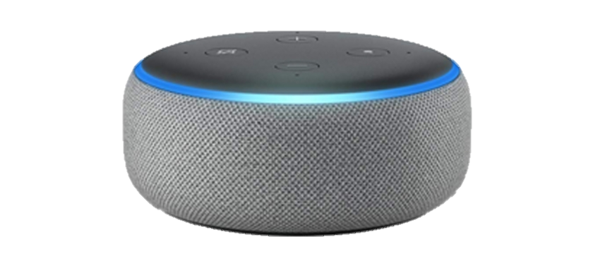
Echo Dots & Adults with Learning Disabilities
Carrie Sant
Active Support & Assistive Technology Lead
Fitzroy

Slide 2
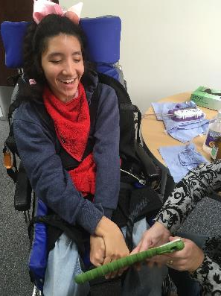
FitzRoy
National charity supporting adults with learning disabilities & autism
Supported living, registered care, day services and their own homes
89 services, 815 people we support

Slide 3
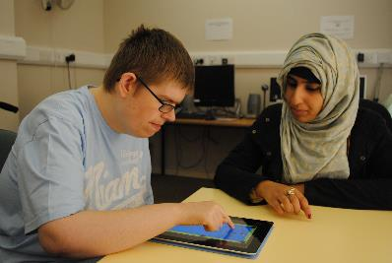
The People We Support
Diverse range of needs and abilities – learning disabilities, autism, communication difficulties, physical disabilities, dementia, mental health issues
Smart speakers can provide increased independence, choice & control

Slide 4
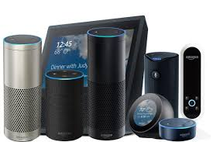
Echo Dots
Voice controlled smart speakers
Information, entertainment, environmental control
Range of shapes, sizes, features & prices
Need an account & a wifi connection
Fairly straightforward to set up

Slide 5
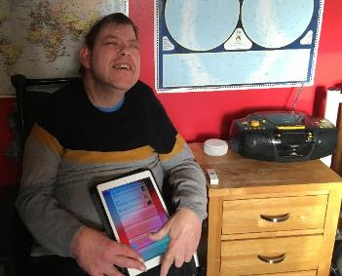
Successes
Kevin is registered blind and his music is incredibly important to him. His amazon echo dot has allowed him to easily interact with and control a music player so that he can choose the songs he wants to listen to and when he wants to listen to them.

Slide 6
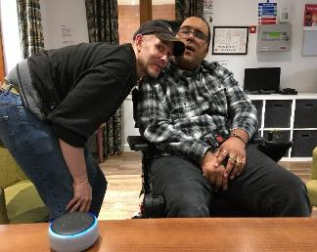
Successes
Banbury and Bicester have one in each of their communal spaces and have started to use them for games, music, to check the weather, find out what’s on in their local area and have even been using them to play pranks!

Slide 7
Successes
Luke and his support worker have been using the amazon echo in their communal lounge to play pranks on the staff, settings timers for Alexa to remind them to drink plenty of water in the middle of the night or make silly noises!
“It’s just really powerful for him”
Service Manager, Claire Twinn.

Slide 8
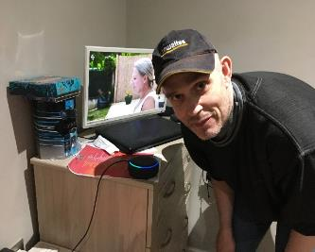
Successes
Chris uses Alexa to listen to music and is learning how to use other skills such as adding to his shopping list when he is running out of something. In the future he is hoping to be able to learn to use it to control his TV and DVD player!

Slide 9
Successes
There has been an echo eruption at Jellicoe Court. As well as having won two echo dots in a competition, one for each of their communal lounges, which are used to play music and make silly noises that get everyone laughing, the residents have also purchased their own echo dots for use in their flats.

Slide 10
Successes
Sam often speaks very quickly and can have difficulties in making herself understood. Staff can see a clear difference in Sam’s speech since she started interacting with Alexa as she needs to slow down and speak clearly for the echo to work properly for her. This is supporting her communication in other areas.

Slide 11
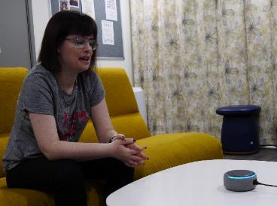
Successes
Nat uses her dot in her room to play music and challenges Alexa to music quizzes! Nat can sometimes feel lonely but she loves the company Alexa provides when she is alone in her flat. Nat also uses hers to check the weather before she goes out as this can be a source of anxiety for her.

Slide 12
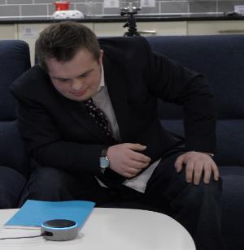
Successes
Jordan uses the echo dot to support him with his work for college, checking spellings and the meaning of words. Jordan has a cheeky personality and loves making everybody laugh by asking Alexa to make silly noises!

Slide 13
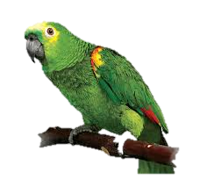
Successes
The Maltings use their echo as an interactive calender with the people we support coming to ask Alexa for a daily morning update about the weather and what other activities might be planned that day. The PWS there have a great sense of humour and also ask Alexa to tell them jokes! One of the people we support, Ben, loves parrots and recently discovered he can ask Alexa to do lots of different parrot calls!

Slide 14
Successes
After some initial technical difficulties the guys at Waterlooville Day Service have got theirs up and running and are using it to play music in the background whilst they enjoy their other activities. Now they have been shown how to do other things like using timers and reminders to start and end sessions and the drop in feature to make announcements to the group in the next room they can’t wait to learn more!

Slide 15
Challenges
Data protection
Account ownership
WiFi access
Smartphone required
Voice recognition
Cost
Staff skills, knowledge & confidence
Notes:
Data protection, capacity & consent – risk assessed, best interests of the individuals, no personal data as such being shared e.g. names, addresses, only their searchable content – services recommended to clear on a regular basis
FitzRoy, or the individual, monitoring of changes to privacy settings, Ts & Cs,
Not all properties have wifi or good wifi, not all have in their own spaces, difficulties at day service due to type of wifi network
Smartphone required to connect to …not all PWS have, not all staff have, often reliant on managers
Not all of the people we support have clear speech that is easily recognised – either inconsistent and frustrating or doesn’t work at all and then they are excluded
Relatively low cost for the dot but prices go up from there, additional costs to be able to connect to environment,
Further complexity if you begin to try and connect to mains lighting etc e.g. SL with fitted LED lamps…just can’t be done
Staff varied in their technical skills, knowledge of smart speakers and smart phones & confidence in setting up and starting to use

Slide 16
Looking to the Future
Expanding use to include environmental controls
Clearer understanding of data protection issues and solutions
Participating in Voice iTT trial
Notes:
- Taking into account all of the challenges previously listed

Slide 17
Contact Information
carrie.sant@fitzroy.org
07971356459
@carrie_sant
LinkedIn
www.fitzroy.org
Any questions?

