Slide 1
MSc in Educational Assistive Technology
Rohan Slaughter 2/11/20

Slide 2
Title: Become a qualified AT: Introduction to the new Educational Assistive Technologist course
Descriptor:
Dundee University recently launched an Educational Assistive Technology MSc. This exciting new course - commencing in January 2021 - will give formal recognition to the role of an Assistive Technologist working in education. Rohan has been instrumental in joining with University of Dundee setting up the course and will describe content, modes of delivery and entry requirements.

Slide 3
Why Assistive Technology?
Assistive technology provision allows students to:
Access the curriculum at all (e.g. a communication aid user)
Access the curriculum at a higher level (e.g. those needing literacy support software)
Allows students improved:
Independence
Access to communication
Access to the environment
Access to leisure opportunities, enjoyment and fun!

Slide 4
Why Assistive Technology
What is Assistive Technology?
“Assistive technology (AT) is any item, piece of equipment, software program, or product system that is used to increase, maintain, or improve the functional capabilities of persons with disabilities. (ATIA definition)
In College contexts we can include:
Computer access devices
Alternative pointing devices, keyboards, other input devices like eye-gaze or switches
Low or no vision / hearing support e.g. screen readers, amplifiers etc.
Communication aids
Also known as AAC – Alternative Augmentative Communication, VOCA – Voice Output Communication Aid
Literacy and numeracy support tools (Read and Write, Dragon, mind mapping tools etc.)
‘Baked into the operating system’ accessibility options (e.g. Windows, MacOS, iOS iPhone, iPads etc.)
Environmental Control Systems (ECS)
Home automation (e.g. media control, lights, heat, windows, doors, blinds etc.)

Slide 5
Who is teaching this course?
Prof Annalu Waller
Rolf Black
Rohan Slaughter, (links to Jisc page)

Slide 6
A brief background on my experience
I have just started as a lecturer at the University of Dundee.
Employed by Jisc as a subject specialist from Sept 2015- Oct 2020:
Provided support on assistive technology and infrastructure to all Jisc members
Previously worked at Beaumont College for more than 15 years:
Developed an integrated Technology service at Beaumont, inclusive of:
Mainstream technology (IT)
Assistive Technology (AT)
E-learning / Technology Enhanced Learning
MIS (Management Information Systems)

Slide 7
Who is this course for?
Anyone who wishes to become an educational assistive technologist (EduAT)
Students could be:
Teachers, or teaching assistants
Therapists, or therapy assistants / technicians
Technologists, from a variety of backgrounds
We expect that most students will have prior experience and/or be working in an AT environment
In some cases we expect that students will already be employed in a suitable context:
Inclusive of education, social care or third sector organisations
In a role that requires the post holder to support the use of AT
For this reason we expect the part time option is likely to be most popular
Where a student is not employed in a suitable context work placements can be identified.

Slide 8
Modes of delivery
The course has two modes of delivery
Full time over one year
Part time over two years
The first intakes are planned from January 2020
The course is blended learning offer:
It will largely be delivered online / remotely
We do plan 2 intensive ‘teaching weeks’
These weeks may not be ‘on-campus’, or ‘in-person’ in 2021 due to the Covid-19 pandemic

Slide 9
Entry requirements
Entry requirements
Honours degree at 2:1 or above in computing, education or a therapeutic subject OR an equivalent qualification (e.g. postgraduate certificate/ diploma of education) OR experience in assistive technology and special education.
You will need to have Protecting Vulnerable Groups (PVG) member status or equivalent (enhanced disclosure).
Experience matters
We have deliberately kept the entry requirements flexible
Students do not need to have a first degree if they have relevant experience
Experience of working in specialist education or within mainstream education, supporting disabled students
Experience of assistive technology assessment, provisioning and ongoing support

Slide 10
Course content: modules
Modules

Slide 11
MSc in Educational Assistive Technology
Core modules:
1 - The Assistive Technologist (20)
2 – Introduction to AT solutions / systems (20)
3 – Assessment for Assistive Technology (20)
4 – AT in educational programmes (20)
5 – Specialist and mainstream AT solutions (10)
6 – Partner relationships (10)
7 – Dissertation project (40)
Plus 40 elective credits (from Education, health/therapy and computing)

Slide 12
Educational Assistive Technology
All modules will have a practical assessment and a theoretical assessment.
Note that all practical coursework is being designed so that students can use work they are carrying out in their home organisation as a basis for the academic work.
This will make the work both relevant to the students working context and more achievable overall, whilst working full time.

Slide 13
1. The Educational Assistive Technologist
1. The Educational Assistive Technologist

Slide 14
1. The Educational Assistive Technologist
Module 1: The educational assistive technologist.
This will include a reflective skills gap analysis to assist the student to select option modules from across the university that can address any required ‘gaps in learning’.
Aims: To define the assistive technologist role in context, noting the elements drawn from technology / computing, therapy / health and teaching / education. This will be carried out through highlighting the key role tasks and responsibilities in a number of scenarios.
Notes:
For some students it’s the difference between flying and failing!

Slide 15
1. The Educational Assistive Technologist
Module 1: The educational assistive technologist.
Indicative content:
The educational assistive technologist role.
Inter-multi-trans disciplinary working.
Individual prior learning and / or skills and experience analysis.
Relevant legal, regulatory, ethical, professional, and social issues associated with the provision of assistive technology.

Slide 16
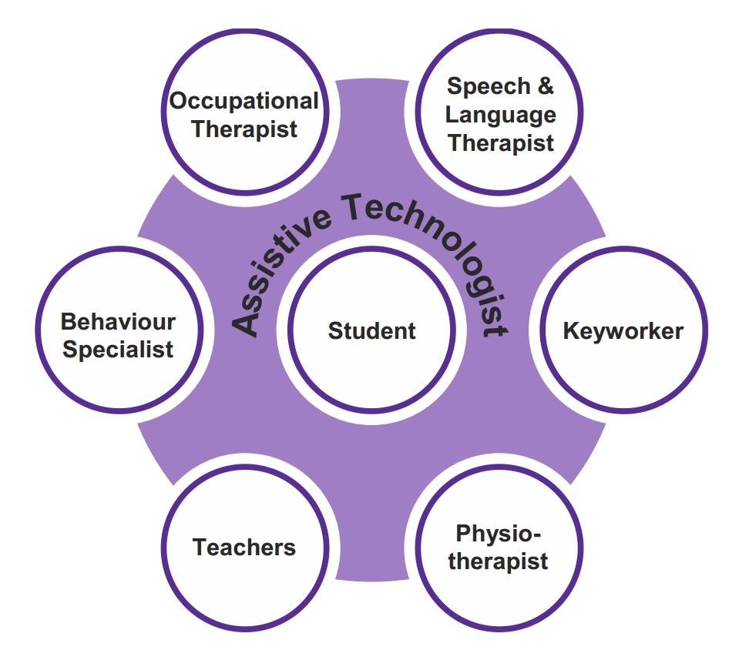
1. The Educational Assistive Technologist
Notes:
In my former context at Beaumont College:
Caseload allocation, all students have a named technologist
Each technologist is allocated a number of teachers/sessions to support
Preparation of resources for SLT / Teachers, that could be student specific or subject specific
Implementation of bespoke or customised hardware and software solutions
Research and development in line with all of the above
Project work
Worked as part of the AAC/AT Community of Practice
The title ‘assistive technologist’ (AT) has a number of different interpretations:
One is Clinical, and refers to ‘clinical rehab engineers’
This is common in the NHS
Beaumont College and the DART project uses a somewhat different definition:
If anyone wants the sample job description, person spec and role profile please contact me
This job is more education focussed, and as such the post holders:
Ideally should have a teaching qualification, minimum 7307/7407/PTTLS or equivalent, and preferably a PGCE/cert ed
Be educated to degree level in an IT related subject or have equivalent skills and knowledge gained from a suitable setting
We want ‘people’ people who are technically literate
This post is intended to be occupied by a flexible, adaptable individual who knows enough about each discipline to know when to make reference to the required professionals in order to deliver a trans-disciplinary approach with the assistive technologist acting as the 'primary integrator' of the solution that is developed for an individual. The assistive technologist is also responsible for teaching and or supporting the individual to use the solution.
This approach can also result in cost savings as much of the technology that will be used is based on off the shelf equipment such as low cost tablet PC computers and computers derived from 'netbook' technology, using detailed case studies we aim to enable other institutions to replicate the solutions we put in place - at a much lower cost that commercially available 'disability' badged products. We will of course need to make use of some specialist hardware and software, but the overall cost of the solutions will be less than could otherwise be 'purchased'.

Slide 17
Recruiting Assistive Technologists
Recruiting AT’s is a challenge
There is no obvious professional qualification or route into this role
Often have to train up people based on a strong experience in one of the three key domains
Therapy
Education
Technology
It is very rare to recruit someone who is instantly able to fully undertake this role
Should emphasise we are looking for people with strong interpersonal skills first
The first step is a skills audit to identify strengths / weaknesses.

Slide 18
2. Introduction to AT solutions / systems
2. Introduction to AT solutions / systems

Slide 19
2. Introduction to AT solutions / systems
Module 2: Introduction to assistive technology solutions / systems.
This module will cover the full range of assistive technology hardware and software. Guest lectures will be provided by experts on particular technologies, and is likely to include delivery from AT developers, suppliers and experts working in other universities and colleges.
Aims:
To introduce students to a range of assistive technology (AT) hardware and software and contextualise the use of such to address function for people with specific physical disabilities and learning difficulties.

Slide 20
2. Introduction to AT solutions / systems
Indicative content:
Social, participatory and medical models of disability.
Definitions of assistive technology and justification for selection.
Assistive technology hardware.
Assistive technology software.
Mounting systems and other physical adaptations or accommodations required to enable access.
AAC (augmentative and alternative communication) technology
ECS (environmental control systems)
Adaptation of mainstream devices for use as assistive technology
Relevant legal, regulatory, ethical, professional and social issues associated with the provision of assistive technology.
Notes:
Intended learning outcomes
Knowledge
To critically reflect on different models of disability in order to inform learner-centred assistive technology provision.
To critically evaluate assistive technology hardware, software and other systems (e.g. mounting accessories) in order to contextualise their appropriate use.
Subject-specific practical and intellectual skills and attributes
To research and critically evaluate specific assistive technologies that are appropriate for consideration to enable a person with disabilities to access computing, communication or their environment.
To consider the contemporary regulatory, legal, ethical, professional and social issues associated with the provision of assistive technology.
Transferrable, employability and enterprise skills and attributes
To develop and apply problem-solving, communication, teamworking, time-management, self-assessment and independent study skills.

Slide 21
3. Assessment for assistive technology
3. Assessment for assistive technology

Slide 22
3. Assessment for assistive technology
Module 3: Assessment for assistive technology.
This module will provide a detailed methodology for the needs-based assessment process. The module will be heavily focused on a student / learner led approach, which must include the views / wants / needs of the student.
Aims:
For students to gain an in-depth understanding of the needs-based, learner-centred assessment process.
This will also include an overview of the provisioning, review and ongoing support of assistive technologies in context.
In order to achieve a high-quality assessment process, the importance of multi, inter and trans-disciplinary working with other professionals will be explored.

Slide 23
3. Assessment for assistive technology
Indicative content:
Disabilities and technologies that support independence for individuals
Models of assessment for assistive technology provision
Inter-multi-trans disciplinary working, including joint assessments with other professionals
Assessment documentation
Relevant legal, regulatory, ethical, professional and social issues associated with the provision of assistive technology.
Notes:
Intended learning outcomes:
Knowledge
To critically evaluate different assistive technology assessment models.
To apply in context the various stages of the assessment process including:
Pre-entry assessment
Initial assessment
Provisioning of equipment, software and systems
Ongoing review and re-assessment
Training and other support for the individual user and those who support them
To critically reflect on the interaction between professional groups, and the management of responsibility and cooperation between disciplines in order to dynamically determine the appropriate professional that is to take the lead role in a given situation.
Subject-specific practical and intellectual skills and attributes
To think creatively and to critically evaluate the selection of appropriate assistive technologies in order to provide a high-quality needs-based assessment.
To assemble an ‘assessment kit’ of equipment that is:
a) appropriate to the working context / can address the needs of the target group of users; and b) will enable a high-quality needs-based, learner-centred assessment to be carried out.
To consider the contemporary regulatory, legal, ethical, professional and social issues associated with the provision of assistive technology.
Transferrable, employability and enterprise skills and attributes
To undertake, document and professionally justify equipment and software selection in a given context.
To develop and apply problem-solving, communication, teamworking, time-management, self-assessment and independent study skills.

Slide 24
4. AT in educational programmes
4. AT in educational programmes

Slide 25
4. AT in educational programmes
Module 4: AT in educational programmes.
This module covers the knowledge the EduAT needs to know to embed AT systems into taught programmes, inclusive of working with teachers or OT’s to scale the use of a system over time.
Aims:
To equip students to successfully embed assistive technology (AT) within educational programmes, inclusive of the requirements for inter, multi or trans-disciplinary working.
Relevant documentation and regulatory considerations will be considered.

Slide 26
4. AT in educational programmes
Indicative content:
Embedding AT within taught programmes inclusive of subject, level and context specific examples
Educational practice (inclusive of relevant glossary of commonly used educational vocabulary)
Methodology for inclusion of AT elements within education specific documentation
Inter-multi-trans disciplinary approaches to including AT within taught programmes
Safeguarding and acceptable use policies and procedures and how they impact on various AT use
Risk assessment and general e-safety and safeguarding practice.
E-learning best practice
AT funding in educational contexts
Regulatory frameworks and AT provision / practice government.
Notes:
Intended learning outcomes:
Knowledge
To critically reflect on the inclusion of AT within taught compulsory education and within lifelong learning scenarios.
To critically evaluate the potential improvements to student outcome measures through the provision of a functional ‘working medium’ that is appropriate to the subject, level and content.
To compare and contrast current regulatory and funding frameworks for AT within education.
To critically reflect on the integration of AT into taught and lifelong learning scenarios and to evaluate methods for social networking and access technology, taking account of safeguarding / e-safety requirements.
Subject-specific practical and intellectual skills and attributes
To embed AT within taught programmes inclusive of subject, level and context specific examples.
To undertake a risk assessment for access to various technologies, inclusive of web-based technologies, demonstrating an understanding relevant decision-making guidance, safeguarding, and social media / rich web services access.
To critically reflect on the interaction between professional groups, and the management of responsibility and cooperation between disciplines in order to dynamically determine the appropriate professional that is to take the lead role in a given situation.
To consider the contemporary regulatory, legal, ethical, professional and social issues associated with the provision of AT.
Transferrable, employability and enterprise skills and attributes
To develop and apply problem-solving, communication, teamworking, time-management, self-assessment and independent study skills.

Slide 27
5. Specialist and mainstream AT
5. Specialist and mainstream AT

Slide 28
5. Specialist and mainstream AT
Module 5: Specialist and mainstream AT.
Covering when and how you might choose to use specialist or mainstream AT. This will include the UDL (universal design for learning) approach, as well as accessibility options baked into mainstream technology. Methods for adapting mainstream technology for more specialist use will also be included.
Aims:
For students to understand the impact of utilising specialist AT and using or adapting mainstream systems.
Examples of different types of AT use in different contexts will be considered.

Slide 29
5. Specialist and mainstream AT
Indicative content:
Dedicated AT/AAC devices and mainstream devices
Mainstream AT hardware
Accessibility options built into operating systems
‘Portability’ of accessibility settings between computers in corporate networks
AT software as a productivity tool for all
Legislation and regulatory frameworks relating to assistive technology provision or practice.
Notes:
Intended learning outcomes:
Knowledge
To critically evaluate the use of mainstream and specialist assistive technology within various scenarios.
To critically reflect on situations where it is appropriate/inappropriate to make use of mainstream systems.
Subject-specific practical and intellectual skills and attributes
To justify the appropriate use of mainstream products or the integration of both specialist and mainstream productions into a given system or solution.
To critically assess the user’s acceptance of a particular technology and reflect on how this impacts on the assessment or selection process and adoption.
Undertake a risk assessment for the use of various mainstream technologies, this should include factors such as device mounting, electrical safety, and other safety critical factors.
To critically evaluate methods to research new potential solutions and maintain skills and currency.
Transferrable, employability and enterprise skills and attributes
To develop and apply problem-solving, communication, teamworking, time-management, self-assessment and independent study skills.

Slide 30
6. AT partner relationships
6. AT partner relationships

Slide 31
6. AT partner relationships
Module 6: AT partner relationships.
This module will cover teaming models for use within an organisation as well as covering how to make referrals to specialised services where these exist. Note that this will be streamed by nation, so students understand the process in the home nation.
Aims:
To give students an appreciation of how partnership working with other bodies can be vital to successful assistive technology provision.
This will involve factors such as transition into or out of a service or educational organisation as well as funding or assessment referrals for particular AT systems or services.

Slide 32
6. AT partner relationships
Indicative content
Funding entitlement variation for AAC or other AT (such as ECS) between the nations of the UK (England, Scotland, Wales and Northern Ireland)
Methods of making referrals to funding or assessment bodies and variation
Routes for funding equipment
Working with other specialists or stakeholders that operate internally or externally to the student’s home organisation
Undertaking joint assessments or providing appropriate reports
Education specific joint-working
Consideration of relevant regulatory and legal frameworks.
Notes:
Intended learning outcomes:
Knowledge
To critically evaluate relevant opportunities to apply for statutory funding for AT and where this does or does not apply to various individuals or contexts.
To critically evaluate situations where it is advantageous (perhaps in terms of saving time) to make use of alternative funding routes such as equipment only referrals for AAC devices.
Subject-specific practical and intellectual skills and attributes
To navigate available funding system options for a given user and technology.
To critically reflect on how and when to make a referral to another specialist that may or may not be employed locally within the same service or organisation as the Educational Assistive Technologist.
To robustly justify an assessment decision to other stakeholders and to understand when to accept useful feedback on why a chosen AT solution should or should not be chosen in a given scenario.
To critically reflect on interactions between professional groups, and the management of responsibility and cooperation between disciplines in order to dynamically determine the appropriate professional that is to take the lead role in a given situation.
To consider the contemporary regulatory, legal, ethical, professional and social issues associated with the selection and provision of assistive technology.
Transferrable, employability and enterprise skills and attributes
To develop and apply problem-solving, communication, teamworking, time-management, self-assessment and independent study skills.

Slide 33
7. Dissertation project
7. Dissertation project

Slide 34
7. Dissertation project
Module 7: Dissertation project
To be based on students working or work placement context.
Aims:
The aim of the project is to give the student experience in carrying out an independent assistive technology project within their work environment.
Notes:
For some students it’s the difference between flying and failing!

Slide 35
7. Dissertation project
Intended learning outcomes:
Knowledge
This will depend upon the particular project undertaken.
Subject-specific practical and intellectual skills and attributes
Experience in researching a need/s within the assistive technology landscape, developing a comprehensive project plan with designing, technical/education work and evaluation.
Designing and evaluating their own project.
Experience in producing a practical solution to a real problem
Using a disciplined approach to using assistive technology in an educational / social setting. This may involve technology adaptation or creation.
Transferrable, employability and enterprise skills and attributes
Independent organisation of work, project planning, time management, report writing, project meetings, communication and presentation skills.

Slide 36
Thank you – any questions?
Rohan Slaughter
Senior lecturer
Twitter @rohanslaughter
rslaughter001@dundee.ac.uk

