Slide 1
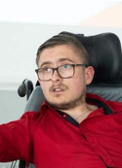
Accessible Gaming
Simon Barnett
SEN Multimedia Tutor
National Star
Josh Reeves
Founder
“Don't Call Me Special” disability rights campaign
@SimonSbarnett
@JoshReevesDCMS
Notes:
1 minute
Both delivering
Keep this brief and explain your role to the audience. We will be able to discuss projects and other collaborations in the Q and A section afterwards.

Slide 2
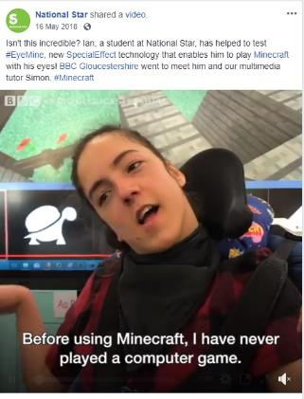
Gamers with Disabilities
Around 92% of people with impairments play games despite difficulties.
AbleGamers estimates there to be around 33 million gamers with disabilities in the US alone.
Source https://ablegamers.org/
Notes:
2 mins
Simon delivering and explaining the impacts he has seen on Able Gamers lives.
https://www.game-accessibility.com/documentation/around-92-of-people-with-impairments-play-games-despite-difficulties/

Slide 3
Benefits of gaming in education
Improves coordination
Improves problem-solving skills
Enhances memory
Improves attention & concentration
Great source of learning
Enhances multitasking skills
Improves social skills
Notes:
1 minute
Simon delivering
Key points. Today we only have 20 minutes, so we will be discussing how you can adapt access for you learners/clients

Slide 4
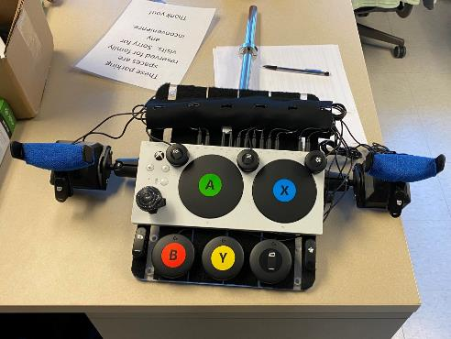
Methods of Inclusion
Smart speakers
Eye gaze
Shared screen platforms
Adapting access
In game settings
Remapping software joytokey.net and rewasd.com
Notes:
2 minutes
There are many ways in which you can ensure the maximum level of inclusion for the people you work with.
Simon delivering
Image source - https://twitter.com/NellyShred4/status/1321501268968288257/photo/1

Slide 5
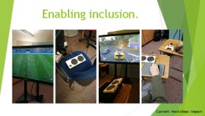
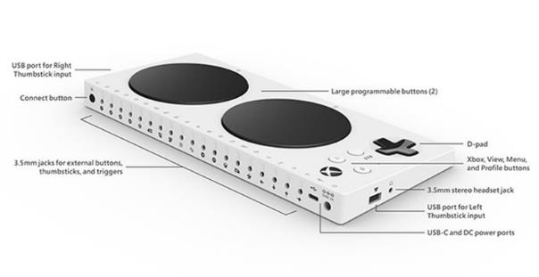
Adapting Access in practice
Notes:
4 minutes
Simon to share screen of learners using adaptive access through the X-Box Adaptive Controller
Follow hyperlink in image for a brief look at all of the how to guides.
https://www.youtube.com/playlist?list=PLUvQt4_vdB-hD_y5FvJf_-pwvcyo0wPTw
Youtube how to guides

Slide 6
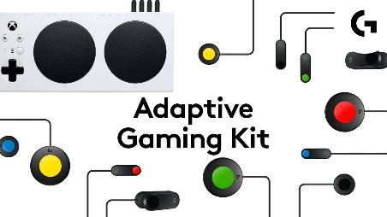
Focused Method: Adapting Access
Using the Logitech Adaptive Gaming Kit you can tailor a controller to you learners needs when it is combined with the Xbox Adaptive Controller
Notes:
1 minute

Slide 7
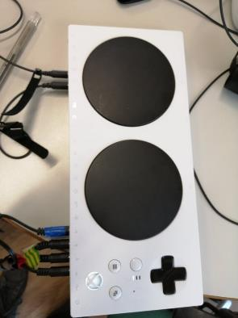
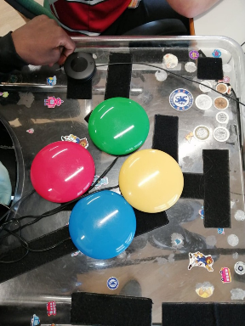
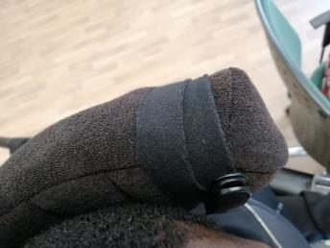
Fifa 2020 set up
Notes:
1 minute
Setting up a learner so that they can use their existing equipment and access methods.

Slide 8
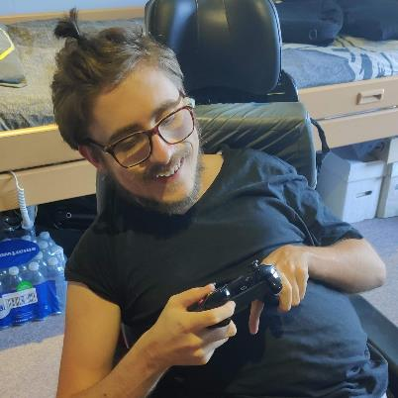
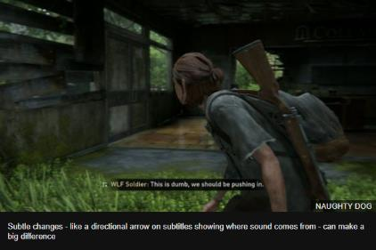
Gaming with my Disability
https://www.bbc.co.uk/news/technology-53093613
Notes:
4 minutes
Josh delivering

Slide 9
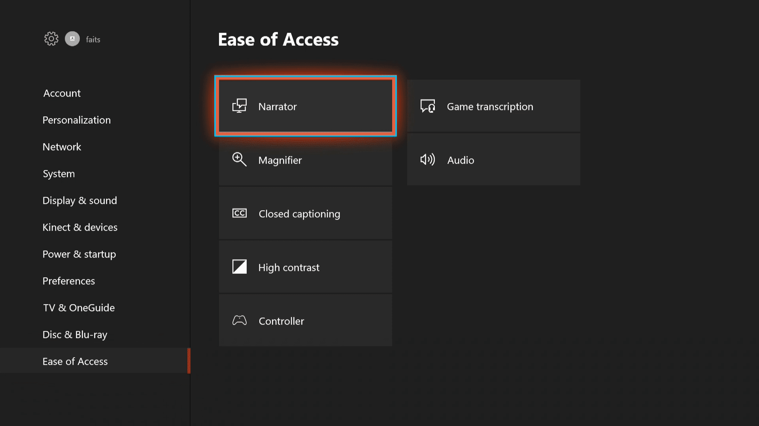
Making it work for me
The Last of Us 2 has embraced accessibility.
Ease of Access settings on the Xbox 1
Remapping your controllers\equipment
Look at the accessibly settings in the game
Notes:
1 minute

Slide 10
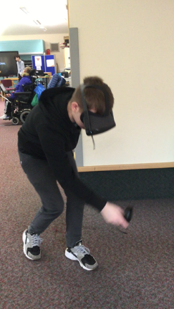
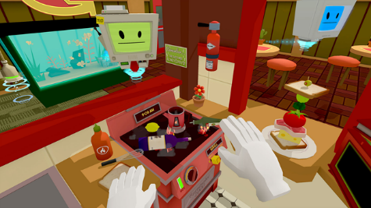
Case Studies
ABI and VR
Building real life skills through gaming.
Notes:
1 minute

Slide 11
How to measure results
Using the Therapy Measure
Ongoing project with results
to follow.
Notes:
1 minute

Slide 12
Community
https://www.specialeffect.org.uk/
Forums for learners we work with are currently underrepresented and without the levels of accessibility some of our learners require.
https://caniplaythat.com/
https://www.twitch.tv/ablegamers
Notes:
1 minute

